Slide 1
Introduction to HTML
Adapted from slides by Crystal Hess

Slide 2
Learning Goals
What is the HTML skeleton?
Why is it important to write proper/valid HTML?
What are some common HTML tags?
Vocab: Internet, Web, HTML, Web Browser

Slide 3
Web Vocab
Internet
The hardware infrastructure of connected computers and wires
World Wide Web (www) (http)
The information on the Internet made up of files and folders stored on computers
Hyper Text Markup Language (html)
The language that we code webpages with
Web Browser
Interprets html and renders it visually

Slide 4
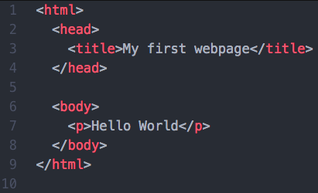
Your first webpage
Open up https://codepen.io/pen/
Type “Hello World!” in the document and save the file as first.html
Go to File Explorer and open the file
There are two ways to view your webpage
Source code view
this is where we right our code
Web browser view
this is where we see how the code we wrote displays on the web
Let’s check out the source code of a site you visit.

Slide 5
Writing Proper HTML
A markup validator checks whether your markup follows the rules
Only allowed elements are used
Tag names are spelled correctly
Opening and closing tags are matched
No grammar rules are violated
W3C Markup Validator
http://validator.w3.org

Slide 6
HTML Skeleton

Slide 7
About HTML tags
HTML tags normally come in pairs like <p> and </p>
Tags should be all lowercase
The first tag in a pair is the start tag, the second tag is the end tag
The end tag is written like the start tag, but with a forward slash inserted before the tag name
Properly nesting tags means that you must close the most recently opened tag before closing an earlier tag;
e.g. <p><strong>Like this</strong></p> not <p><strong>Like this</p></strong>

Slide 8
Common HTML tags
<html>
<head>
<title>
<body>
<p>
<br />
<h1>
<strong>
<em>
<blockquote>
<hr>
<img />
<ol>
<ul>
<dl>
<pre>
<table>
<link>
<li>
<a>

Slide 9
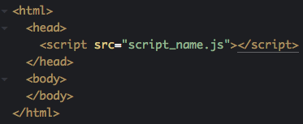
What you need to know for this class

